Slide 1


DarkBERT: A Language Model for the Dark Side of the Internet
Individual Task 2
Group 5
Submitted by:
Name: Taslima Islam
ID: 20101603
Section: 1
Submitted to: Annajiat Alim Rasel (AAR)
RA: Mehnaz & Sabbir

Slide 2

Introduction
DarkBERT, a language model specifically designed to comprehend and process the unique language of the Dark Web. It excels in handling this unique linguistic environment, providing a more accurate and nuanced understanding of Dark Web communications.

Slide 3
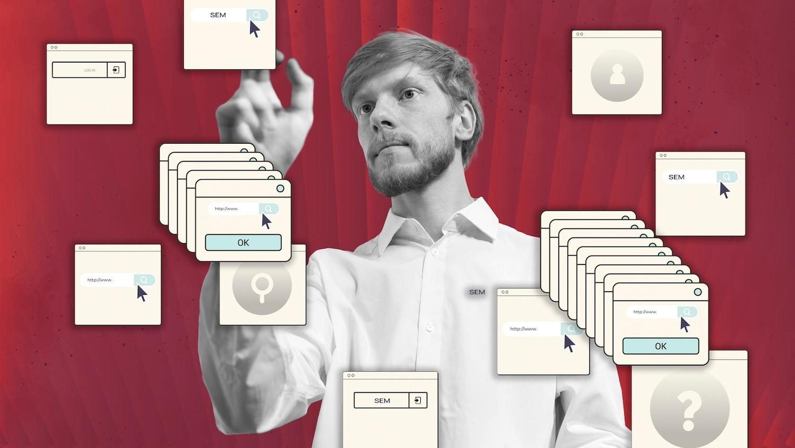
Motivation
Introduce DarkBERT, a language model specifically designed for the Dark Web.
Highlight the advantages of DarkBERT over conventional language models.
Demonstrate DarkBERT's effectiveness in various tasks specific to the Dark Web.

Slide 4
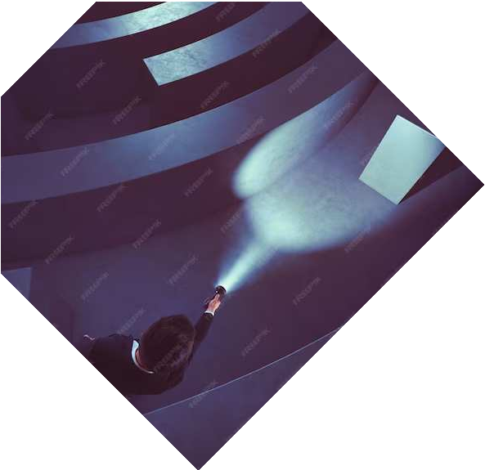

Contribution
The primary contribution of the authors in this paper is the development of DarkBERT. This is a significant advancement in the field of NLP and has the potential to enhance cybersecurity efforts and provide valuable insights into illicit activities on the Dark Web.
Design and development of DarkBERT.
Evaluation of DarkBERT's effectiveness.
Highlighting the advantages of DarkBERT.
Demonstrating DarkBERT's potential applications.
Developed a powerful tool for understanding the Dark Web.
Enhanced cybersecurity efforts.
Provided insights into the hidden corners of the internet.
Improved Dark Web research.
Contributed to the development of new technologies.

Slide 5


Methodologies
The author's evaluated DarkBERT's performance on various tasks specific to the Dark Web.
They curated a massive dataset of text from various Dark Web sources.
Trained DarkBERT using a specialized training process.
DarkBERT was then evaluated on its ability to identify and classify Dark Web content, detect ransomware leak sites, and filter out sensitive information.
DarkBERT outperformed conventional language models on all of these tasks, demonstrating its
effectiveness in understanding and processing Dark Web content.

Slide 6


Dataset
The authors collected a massive dataset of text from various Dark Web sources using a two-pronged approach:
Collecting Seed Addresses: From Ahmia, a publicly available repository of onion domains.
Crawling the Dark Web.
To ensure the quality and relevance of the collected data, the authors implemented several filtering and processing steps:
Language Identification: by using fastText.
Content Filtering.
Noise Removal.
The paper utilized two primary datasets:
Dark Web Content Dataset: 6.1 million filtered and processed Dark Web content.
Ransomware Leak Site Dataset: 105 positive examples and 679 negative examples.

Slide 7
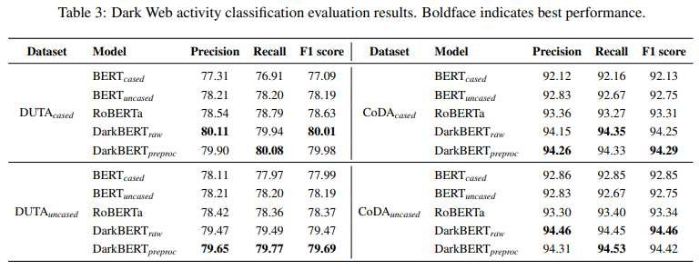
Result
Add a body text

Slide 8

Result
The results obtained in this paper are summarized below:
Identifying and Classifying Dark Web Content: It achieved an average F1 score of 96.2% across five
categories.
Detecting Ransomware Leak Sites: It achieved an F1 score of 98.9% on the ransomware leak site dataset.
Filtering Out Sensitive Information: It achieved an average F1 score of 98.5% across three categories of
sensitive information.
Comparison with Conventional Language Models:
DarkBERT outperformed conventional language models, such as BERT and RoBERTa, on all evaluation tasks.

Slide 9

Limitations
Dataset limitations: The paper acknowledges that DarkBERT's training dataset may not be fully representative of all the diverse content and language variations found on the Dark Web. This means that DarkBERT's performance may be limited in understanding certain types of Dark Web content.
Training bias: The DarkBERT model may inherit biases from the training data.

Slide 10

Future Work
Future research such as Refining DarkBERT's capabilities, to understand and process even more complex and nuanced Dark Web content.
Expanding DarkBERT's applications. Addressing ethical considerations.
Adapting DarkBERT to evolving Dark Web landscapes.

Slide 11
Conclusion
In conclusion, the unveiling of DarkBERT represents a significant milestone in illuminating the unseen depths of the internet. This groundbreaking language model has the potential to transform our understanding and interpretation of online content, paving the way for a more informed and comprehensive digital landscape.

Slide 12
References
Ranaldi, L. (2022, January 14). The dark side of the language: Pre-trained transformers in the DarkNet. arXiv.org. https://arxiv.org/abs/2201.05G13
Devlin, J., Chang, M., Lee, K., & Toutanova, K. (2019). BERT: Pre-training of Deep Bidirectional Transformers for Language Understanding. ACL Anthology. https://doi.org/10.18G53/v1/n19-1423
Choshen, L., Eldad, D., Hershcovich, D., Sulem, E., & Abend, O. (2019). The Language of Legal and Illegal Activity on the Darknet. ACL Anthology. https://doi.org/10.18G53/v1/p19-1419
Liu, Y. (2019, July 2G). ROBERTA: A robustly optimized BERT pretraining approach. arXiv.org. https://arxiv.org/abs/1907.11G92
Yoon, C., Kim, K., Kim, Y., Shin, S., & Son, S. (2019). Doppelgängers on the Dark Web: A Large-scale Assessment on Phishing Hidden Web Services. ACM Digital Library. https://doi.org/10.1145/3308558.3313551
He, S., He, Y., & Li, M. (2019). Classification of Illegal Activities on the Dark Web. ACM Digital Library. https://doi.org/10.1145/3322G45.3322G91

Slide 13



Thanks for watching!

